Slide 1
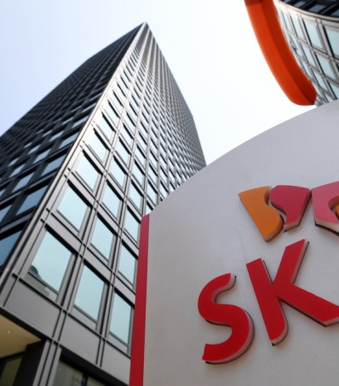
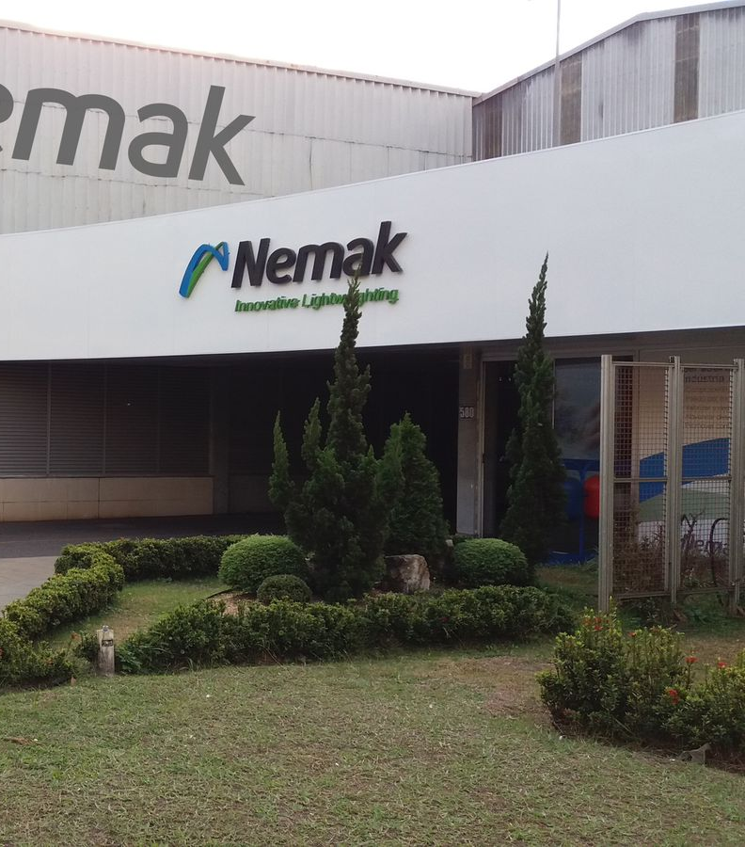
{COMPANY NAME}
{MONTH} - {YEAR}

Slide 2
{COMPANY_NAME} - Company Overview
Company Snapshot
Business Overview
Revenue Split (FY24)
Financial Highlight (FY22-24)
``` • Tour Partner Group Limited is a destination management company (“DMC”) that designs, contracts and operates group tours across the United Kingdom, Ireland, the Nordics and North America. • The company trades through five local DMC brands – Hotels & More, Irish Welcome Tours, Trans Nordic Tours, Authentic Vacations and Experience Scotland – giving it multilingual contracting access to more than 8,000 hotels and service suppliers. • It focuses on group leisure programmes, customised special-interest itineraries, FIT products and high-end fly-drive packages, serving tour operators and travel agents in 40-plus source markets. • The company maintains sales offices in London, Dublin, Copenhagen, San Francisco and Scottsdale, supported by contracting hubs in Berlin and Edinburgh, which together provide 24/7 in-destination support to clients. • It emphasises proprietary technology; its internally-developed TourConnect booking platform enables dynamic pricing, real-time inventory access and direct supplier API connectivity. • The company states that sustainability under its “Make Travel Matter” framework is integral, targeting carbon-neutral operations by 2030 and requiring contracted hotels to sign up to its supplier code of conduct. ```
Revenue Split
Financial Highlights Table
Financial Highlights Commentary
Key Recent Developments
Manufacturing Footprint
Key Recent Developments
Geographical Footprint
Capital Structure Summary (as of Dec-24)
Capital Structure Table
Capital Structure Commentary
Key Stakeholders
Key Stakeholders Table
Sources: Company financial statements, Company website, Debtwire, CIQ, Bloomberg, News
Notes: 1) Advisors to the company; 2) The values for LTM 1Q25 is not included in the financials table as the update does not provide detailed cash flow data; 3) Excluding net working capital and taxes paid

Slide 3
Organisational Structure
Organisational Structure
Organisational Structure
Ultimate Parent
Operating Subsidiary
Focus Company
Debt

